Slide 1
Data Management Plan Tools
Michele Reilly
University of Houston
March 7, 2012
Scholarly Communications Group

Slide 2
What is Data Management and why do you need a plan?
Conceptualized in the 1980s.
Sharing, efficiency, protection
More accessible to other researchers
Saves the researcher time during and after the grant period
Leads to better science.

Slide 3
Data Management Plans
On January 18, 2011 NSF requires a data management plan attached to grant applications. http://www.nsf.gov/bfa/dias/policy/dmp.jsp
Other agencies are getting into the act

Slide 4
Overwhelming, much!
How can librarians help researchers?
Provide tools
Provide face-to-face or phone walk through.

Slide 5
What tools are out there?

Slide 6
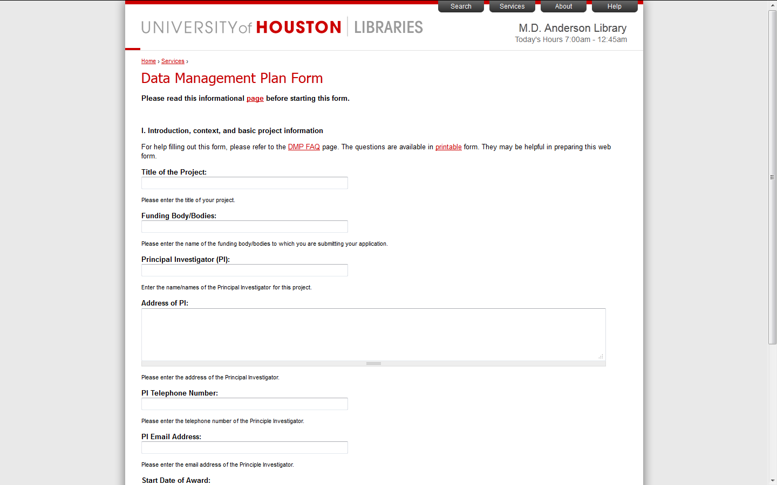
http://info.lib.uh.edu/services/data-management-support

Slide 7
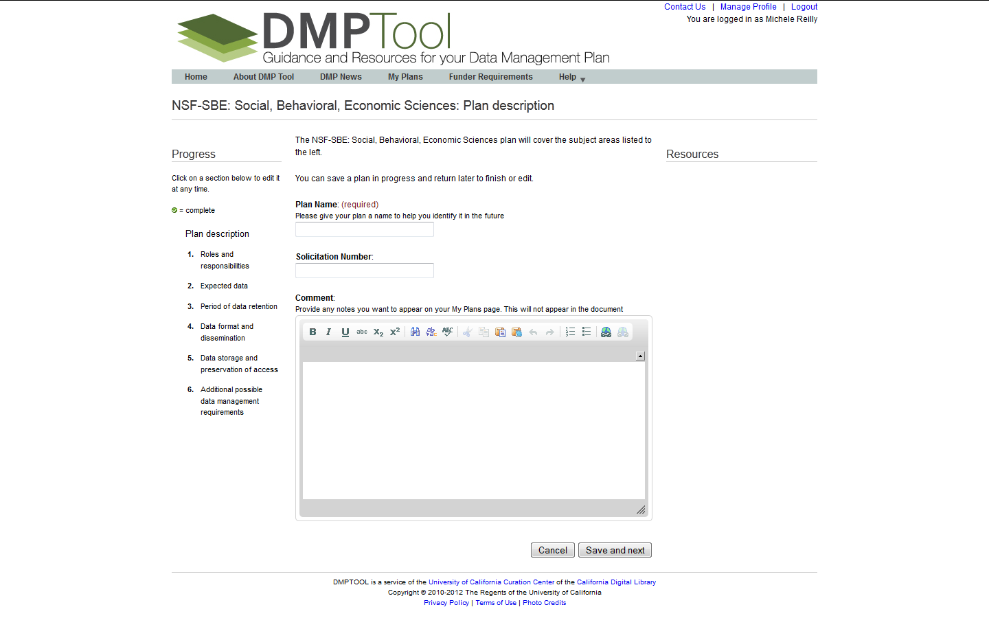
https://dmp.cdlib.org/

Slide 8
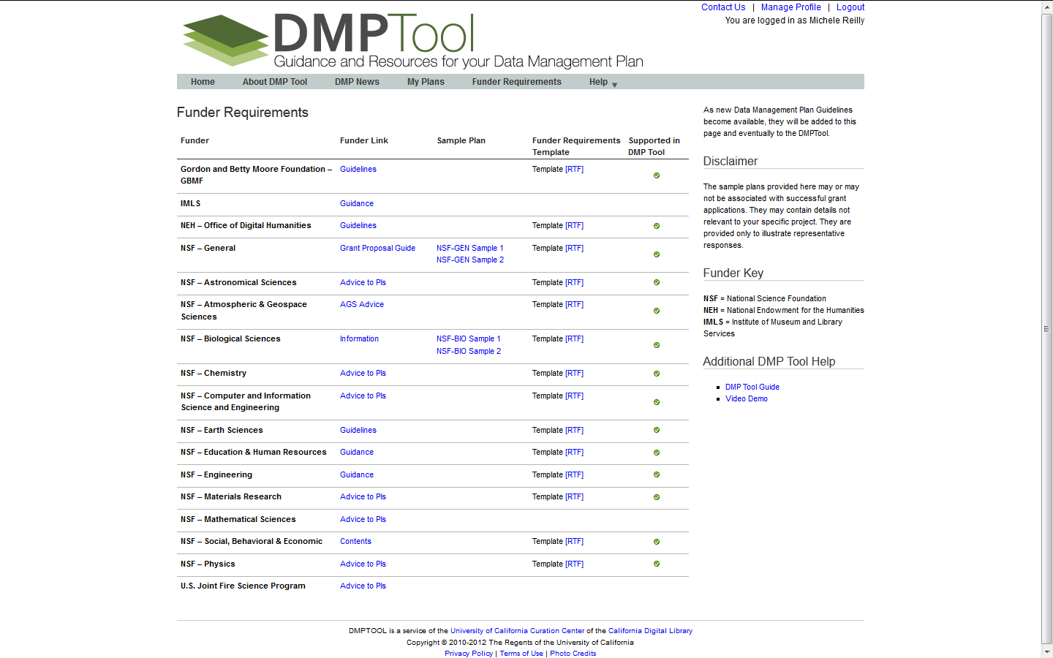
Notes:
The funder requirement link pulls up
the link to the funder,
a funder requirements template
and let’s you know whether the DMP Tool supports that particular funder. Very nice.
The help offers a step-by-step guide to using the tool and the also have an interesting Demo video.

Slide 9
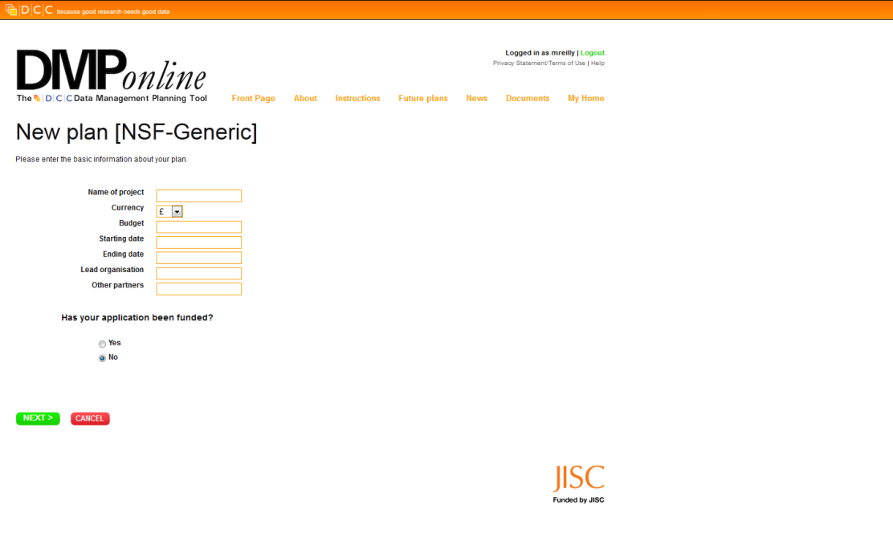
https://dmponline.dcc.ac.uk/

Slide 10
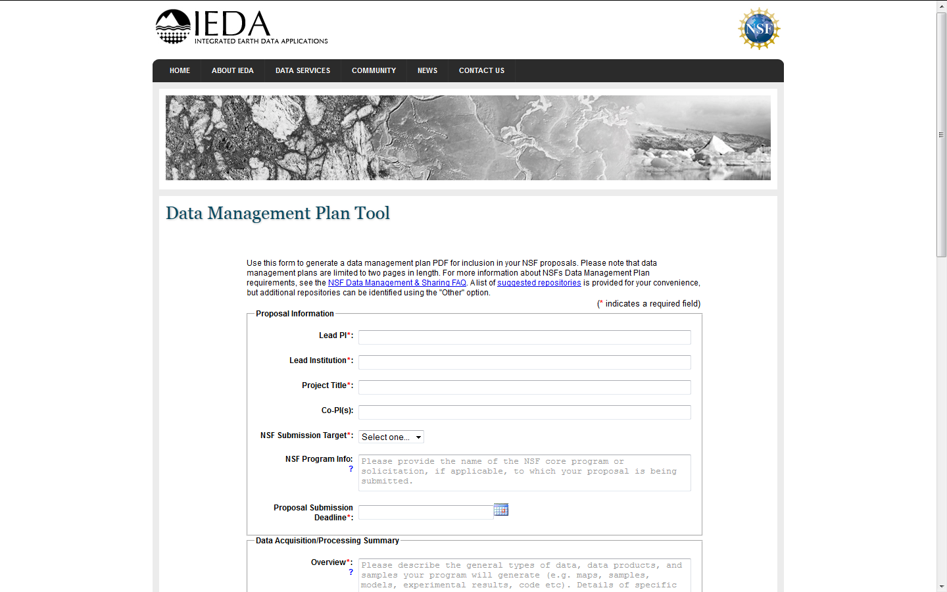

Slide 11
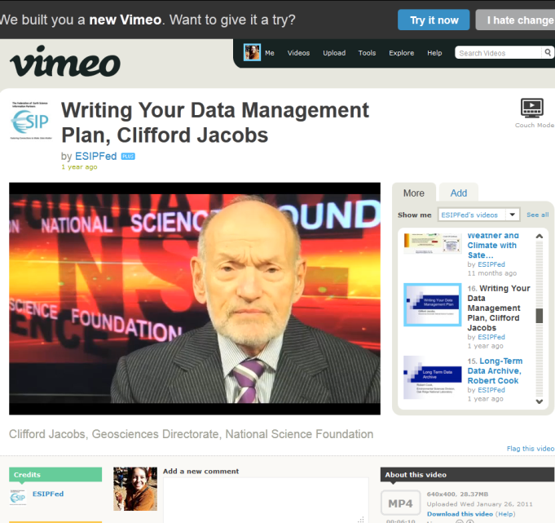
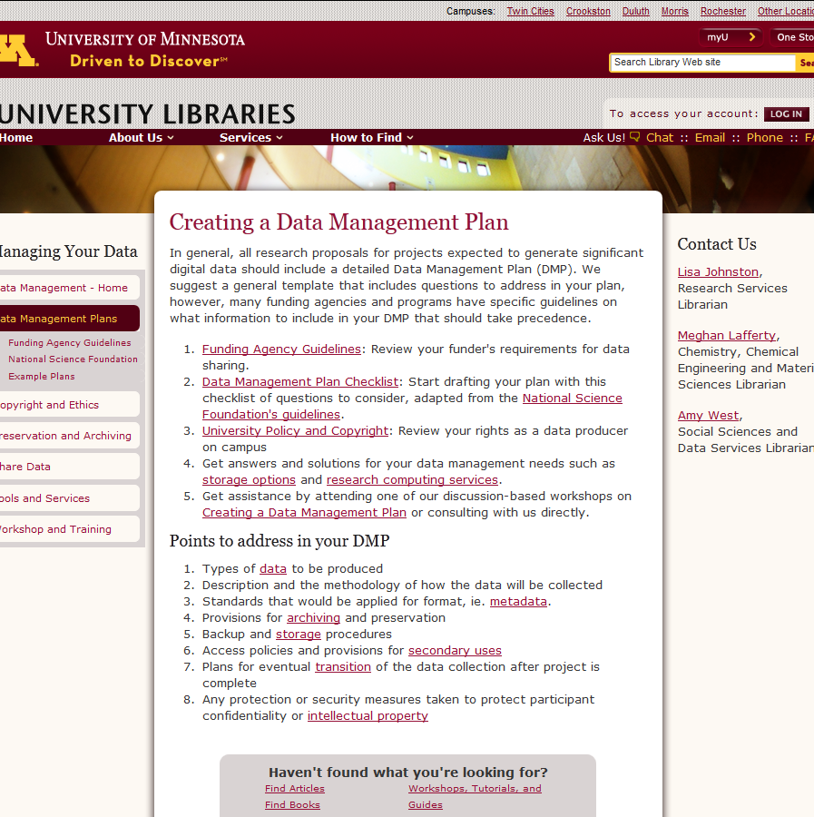
Lots of other information

Slide 12
Questions
Michele Reilly
University of Houston Libraries
mreilly@uh.edu
713-743-8995

