Slide 1
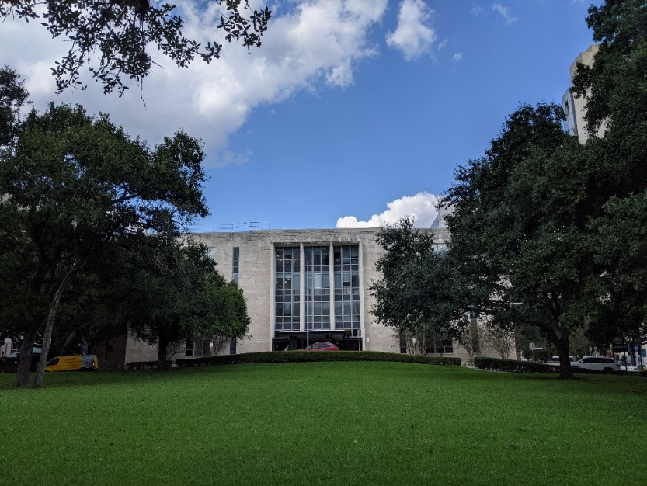
Bringing Open Access Peer-Reviewed Journals to the Community and Beyond: Using DigitalCommons@TMC As Example
Alice Sherwood
Systems Librarian

Slide 2
Introduction: The TMC Library
Inside The TMC Library: Study Space
Study Room at The TMC Library

Slide 3
DigitalCommons@TMC
An online repository sponsored by The TMC Library since early 2000s dedicated to serving as a scholarly resource for member institutions of the Texas Medical Center (TMC)
Over 8000 articles
Viewed by 140 countries around the world monthly
13250 full-text downloads per month
DigitalCommons@TMC Homepage

Slide 4
Peer Reviewed Journals in DigitalCommons@TMC
7 peer-reviewed journals
1st journal “Journal of Family Strengths” started in 1995
Blinded peer reviews
Open-source e-journal
The Latest Peer Reviewed eJournal

Slide 5
Benefits of Peer-Reviewed Journals on Your Institutional Repository
When managing peer-reviewed journals not having to find a domain to host their site or design how the ejournals looks
Providing Support
Increase repository size
Providing research for community
DigitalCommons@TMC Start Guide

Slide 6
Questions?
Notes:
In this digital age when open data, “data that can be freely used, re-used and redistributed by anyone” is constantly on the minds of many users, it really is a win-win situation for you and your community when you can provide open access ejournals within your doorstep. When might you start hosting peer-reviewed ejournals on your DigitalCommons repository?

